Slide 1




Summer Robotics challenge
Welcome
ROBOTICS
NATION

Slide 2

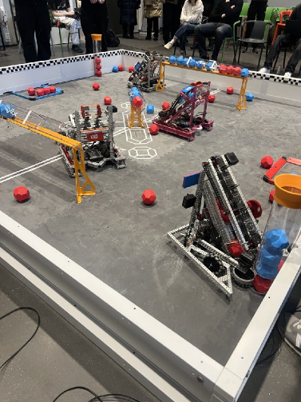
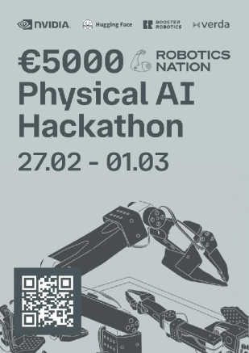
Robotics Nation?
Association set on starting a robotics club in every finnish high school
Want to see more robots in the streets of Finland
If you have a robotics related startup idea let us know, we might be able to help
ROBOTICS
NATION

Slide 3

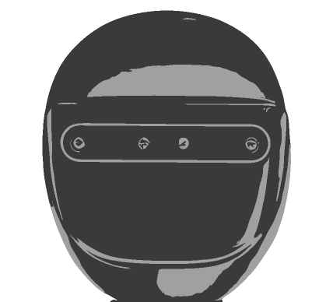


This you?
This you?
Aerorozum
Baymax
Forestbridge
Orika
Primal Intelligence
Robomates
Sunny
Zuper
ROBOTICS
NATION

Slide 4

Your toys (not yours, not toys)
Xlerobot
Jetson Orin Nano 8gb
Meta Quest 3S
Orbbec Gemini 335 camera
Anker Solix CX300 DC (powerbank)
Each team has over 1500e worth of hardware. You are borrowing the parts for 3 months and are responsible to compensate any broken, damaged or lost parts
When you get your hardware check it immediately for defects and let us know.
ROBOTICS
NATION

Slide 5

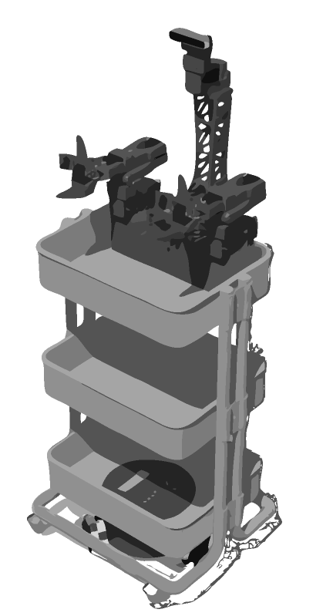


Your challenge & judging criteria
Develop a minimum viable product using the hardware
How good demo
How technically impressive
How good business idea
How much effort gone into this
7000e prize pool shared by top 3 teams
+ marketing award
ROBOTICS
NATION

Slide 6

Timeline
Progress check ups every 3 weeks:
Send a short message to @mailateippi on how its going in tg and some videos or photos
4.7 1st check up
Midway BBQ
13.9 Demo day
You should be comfortable with your setup now
Optional event if you’re keen
15.8 3rd check up
Present results in front of a jury
Find out
13.6 Kickoff
25.7 2nd check up
5.9 4th check up
30.10-1.11 Robotfair
Kickoff, distribution of robots
Fuck around
Panic & start grind
Winners will also present here
ROBOTICS
NATION

Slide 7


The few rules
Upgrading / modifying the hardware everything is allowed
For radical improvements be in touch with us first.
Treat hardware with respect
Dont go outside
ROBOTICS
NATION

Slide 8

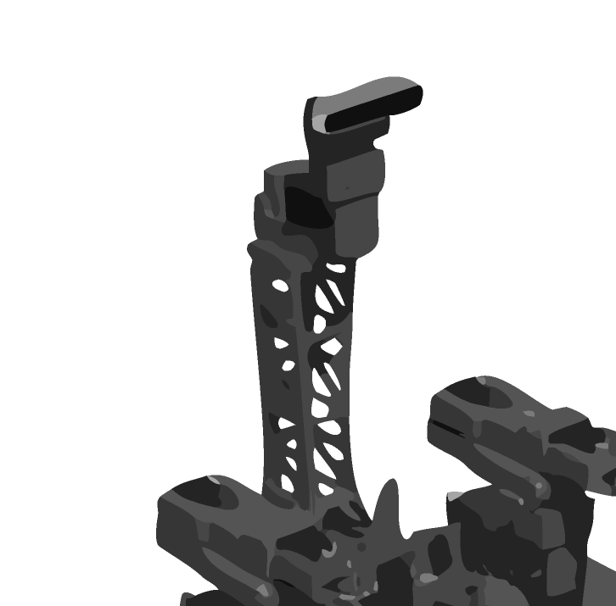


What now?
Come sign the papers and claim your robots.
You have to figure out how to get these out of here
Pizza on the way
Join the official telegram group
Join the unofficial telegram group
Summer Robotics
Aalto Robotics Club
ROBOTICS
NATION

Slide 9


